Slide 1



X
Dashboard Performance Analytics Kimia Farma Business Year 2020-2023
Kimia Farma - Big Data Analytics
Presented by
Rakhmadiani Ardinda Chaerunnisa

Slide 2




Rakhmadiani Ardinda Chaerunnisa
I am a Data Science student in the Faculty of Information Technology and Data Science (FATISDA) at Universitas Sebelas Maret with profiency in Apache Hop, Streamlit, R, Rshiny, Python, SQL Server, Power BI, Tableau, Looker Studio and Excel. I also have experience as a teaching assistant for courses in Linear Algebra, Data Visualization, Statistics, as well as Modeling and Simulation.
LinkedIn
GitHub

Slide 3
About Company
Kimia Farma is a state-owned pharmaceutical company (BUMN) and part of the Bio Farma Group. It is the first pharmaceutical industry company in Indonesia, established by the Dutch East Indies government in 1817. Kimia Farma provides integrated healthcare services ranging from drug manufacturing and distribution to pharmacies, health clinics, and clinical laboratories spread across provinces throughout Indonesia.

Slide 4
Project Portfolio
This project aims to develop a data visualization that analyzes Kimia Farma’s performance from 2020 to 2023. The purpose of this visualization dashboard is to provide insights into profits, best-selling products, worst-selling products, as well as the provinces with the highest and lowest number of transactions.
Project explanation video here!

Slide 5
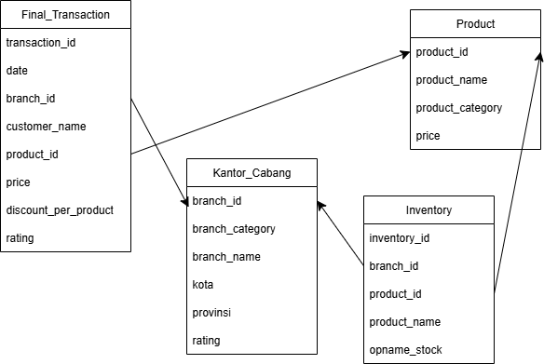
Importing Dataset to BigQuery

Slide 6
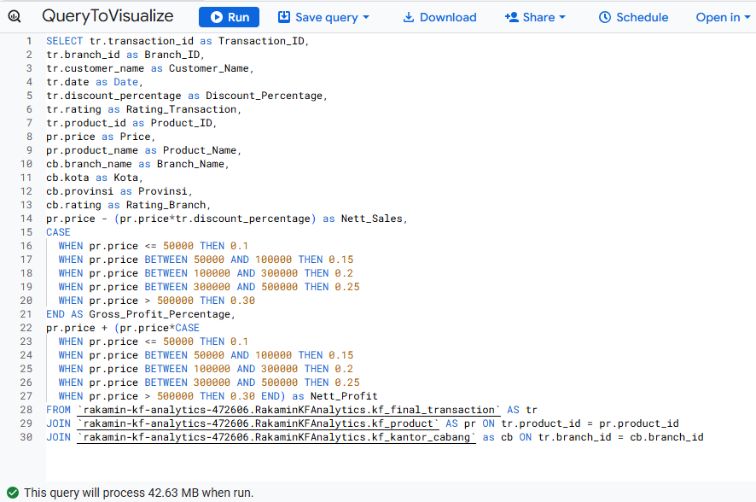
BigQuery Syntax

Slide 7
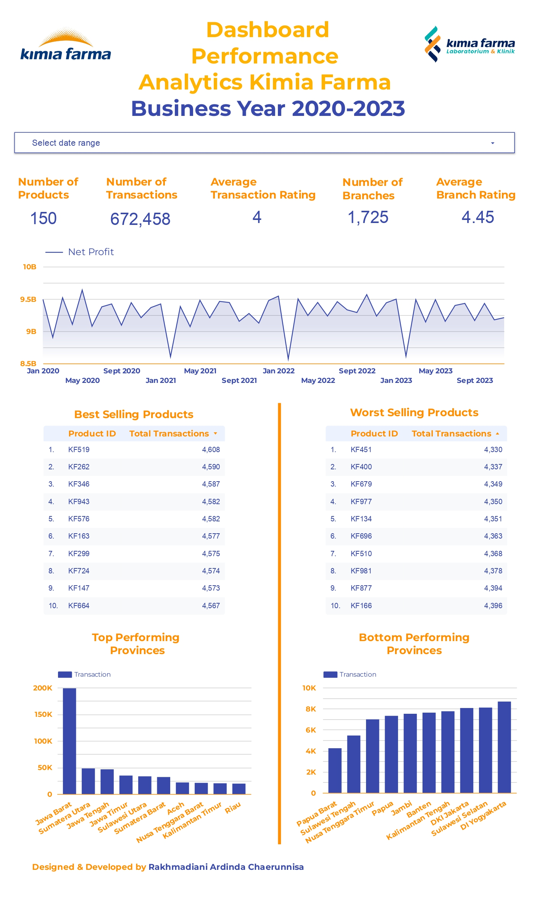

Slide 8
Dashboard Performance Analytics
1. Profits have experienced fluctuations, with a significant decline occurring every February from 2021 to 2023. Overall, profits have remained stable within the range of IDR 9 billion to IDR 9.5 billion.
2. The top 10 products can be interpreted as those most frequently demanded by customers. The products should be stocked in greater quantities to ensure constant availability.
3. The bottom 10 products can be understood as those less frequently sought by customers. However, they should not be discontinued, as they are likely purchased by customers with rare medical conditions.

Slide 9
Dashboard Performance Analytics
4. West Java has become the province with the highest number of transactions. The solution is to increase the availability of medicines and establish more branches in West Java to make it easier for customers to access pharmaceutical products.
5. West Papua has recorded the lowest number of transactions. The solution is to analyze the primary medicines required by customers in the region. Medicines with low demand should have their distribution adjusted to reduce costs and minimize losses, while the stock of essential medicines most needed in West Papua should be increased.

Slide 10
Thank You
X

